Slide 1
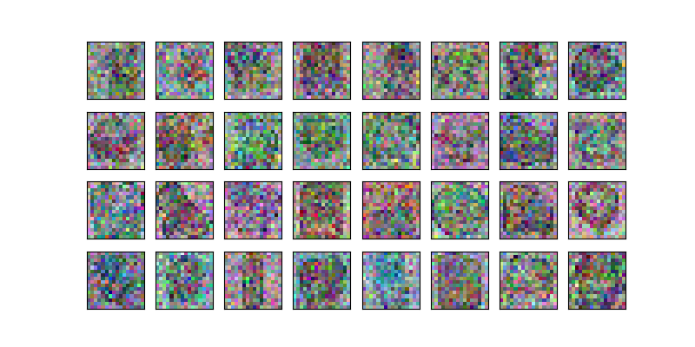
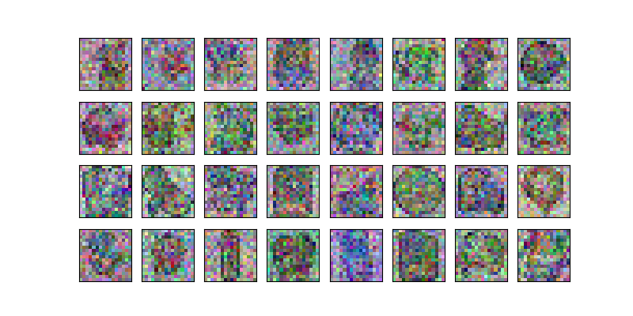
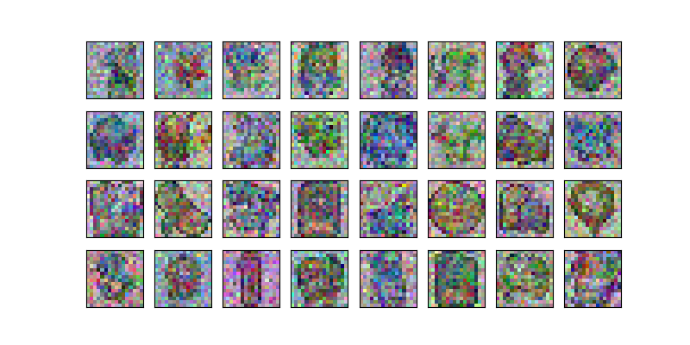
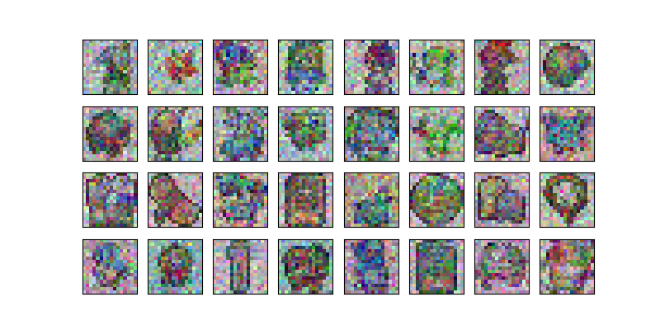
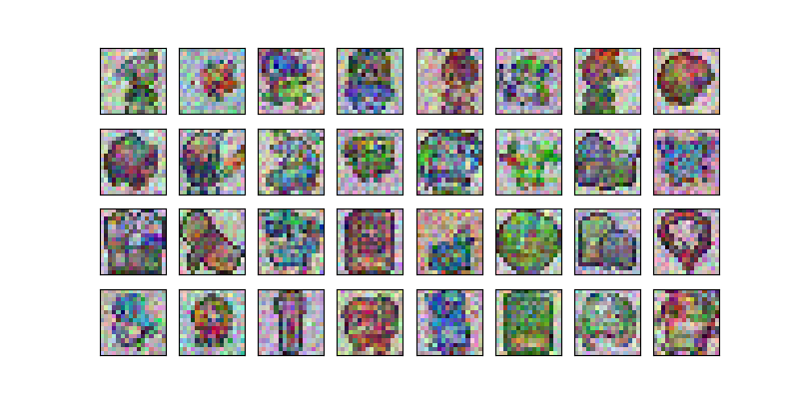
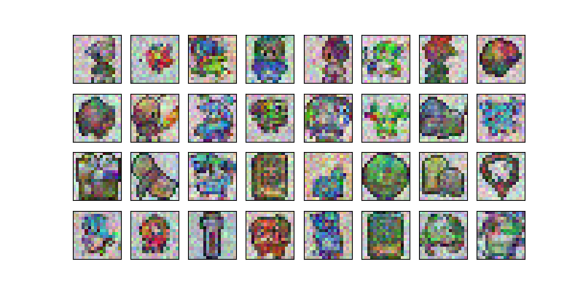
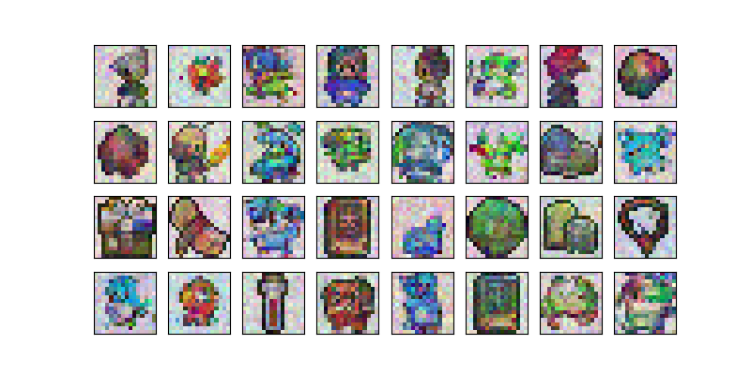
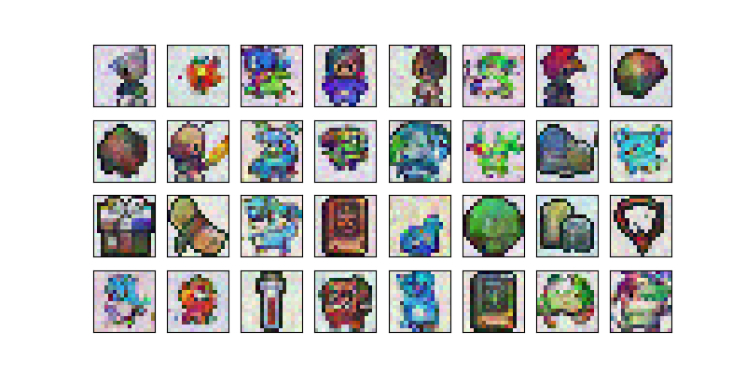
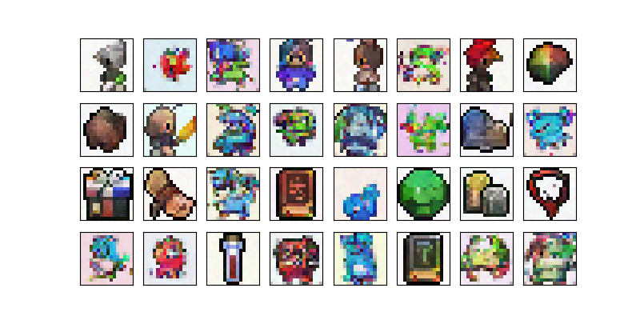
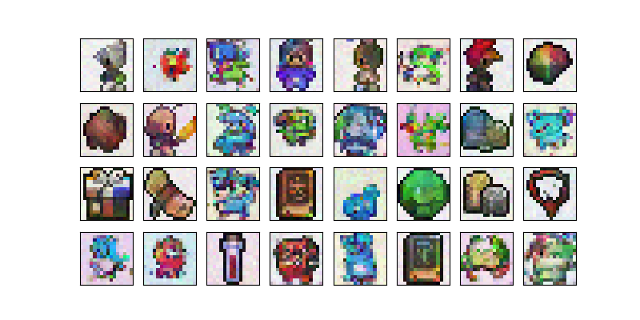
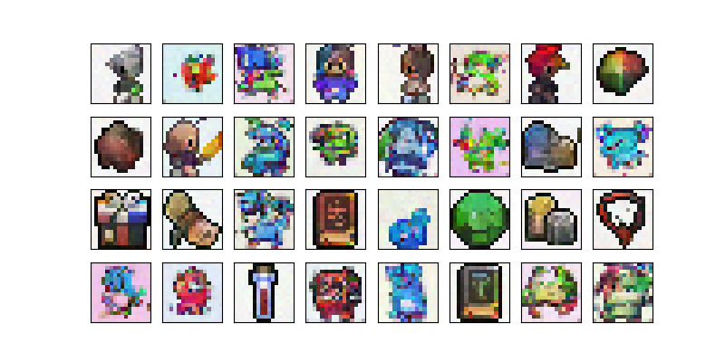
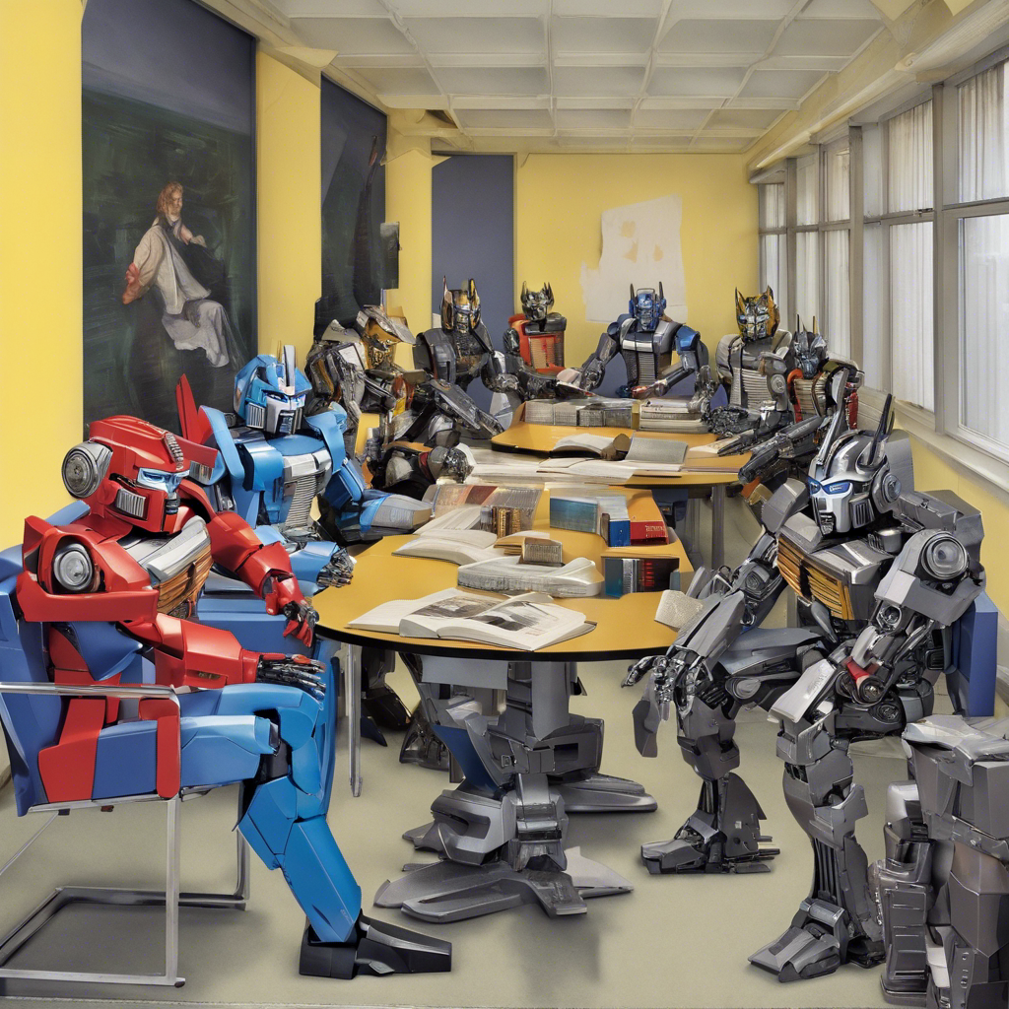
Stable Diffusion
Edmund Dable-Heath

Slide 2
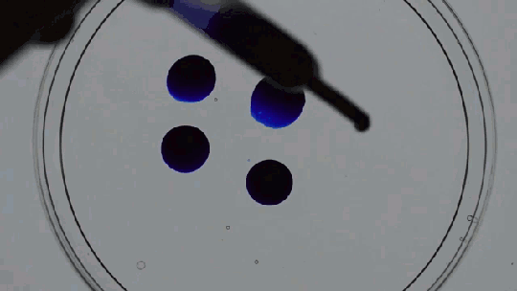
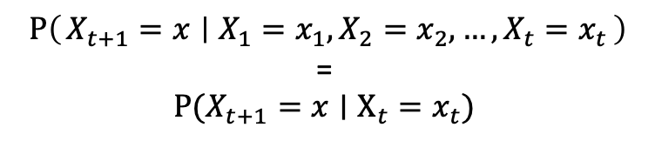
Diffusion in the physical world
Time-dependent random process of something moving from an area of high concentration to low concentration.
How do we model this?
If we know exactly how we got to a diffuse state, can we get back to a concentrated one?
$$P\left(X_{t+1}=x ∣ X_{1}=x_{1},X_{2}=x_{2},…,X_{t}=x_{t}\right)$$
=
$$P(X_{t+1}=x∣X_{t}=x_{t})$$
Notes:
If you've seen Oppenheimer, he's the one playing Bongos.

Slide 3
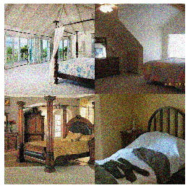
Diffusing Images
Consider an image as a concentrated collection of coherent information within pixel space.
Then we can think of adding noise – or blurring the image – as diffusion.
Taking a trip through the image library of babel.
Notes:
Explain dirac notation!

Slide 4
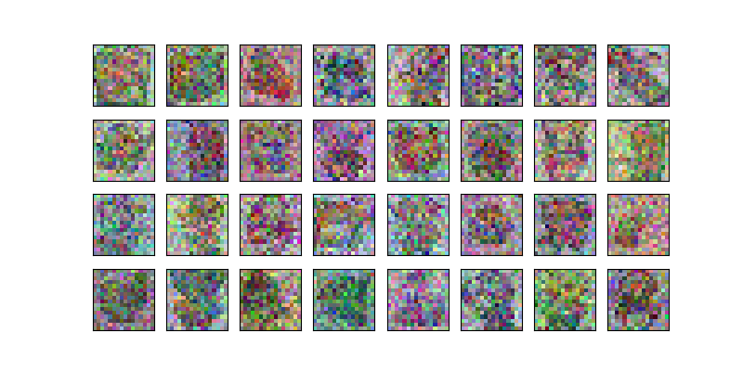
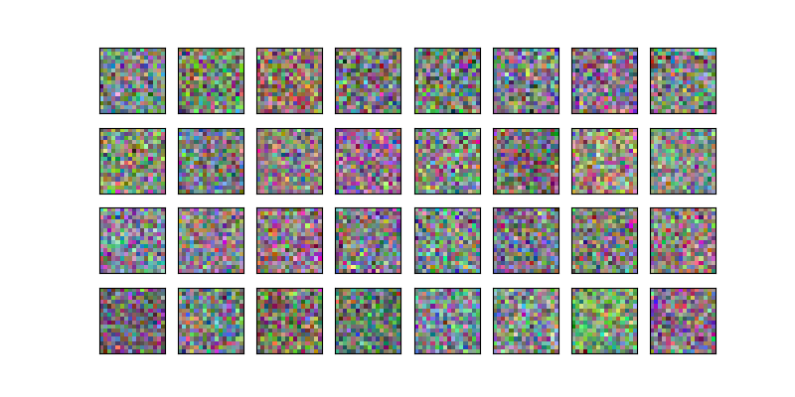
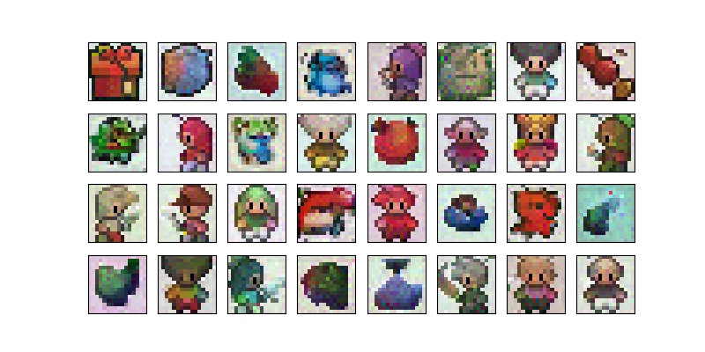
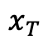
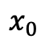
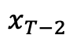
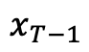
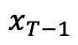
So what do these models look like?
Neural
Net
Remove
Noise
$$x_{T}$$
$$x_{T−1}$$
Neural
Net
Remove
Noise
$$x_{T−1}$$
$$x_{T−2}$$
Repeat
$$x_{0}$$

Slide 5
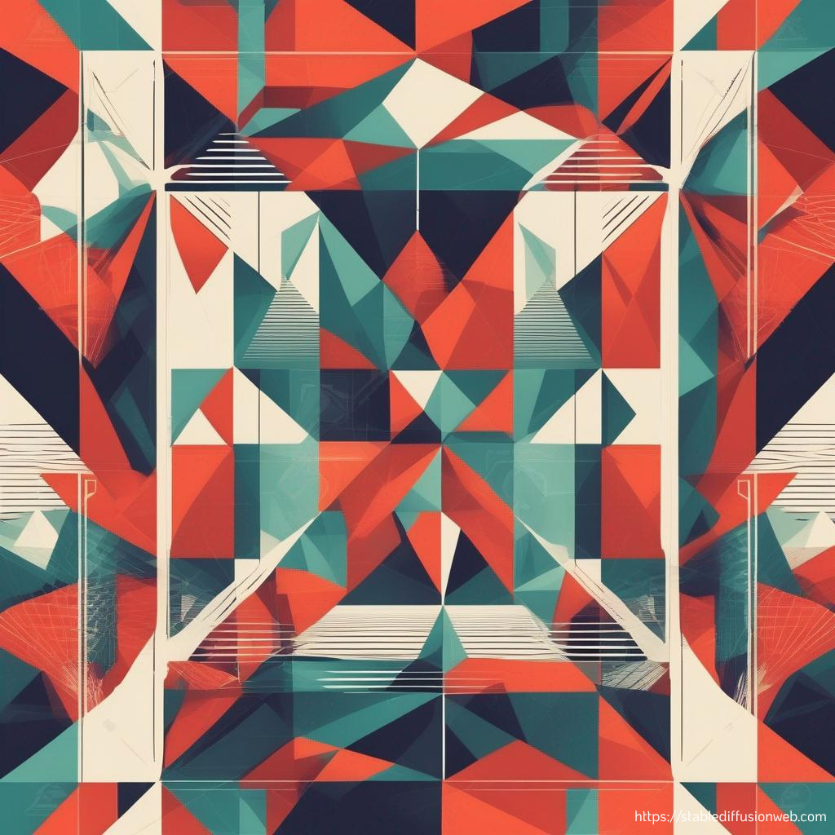
Architecture Overview

Slide 6
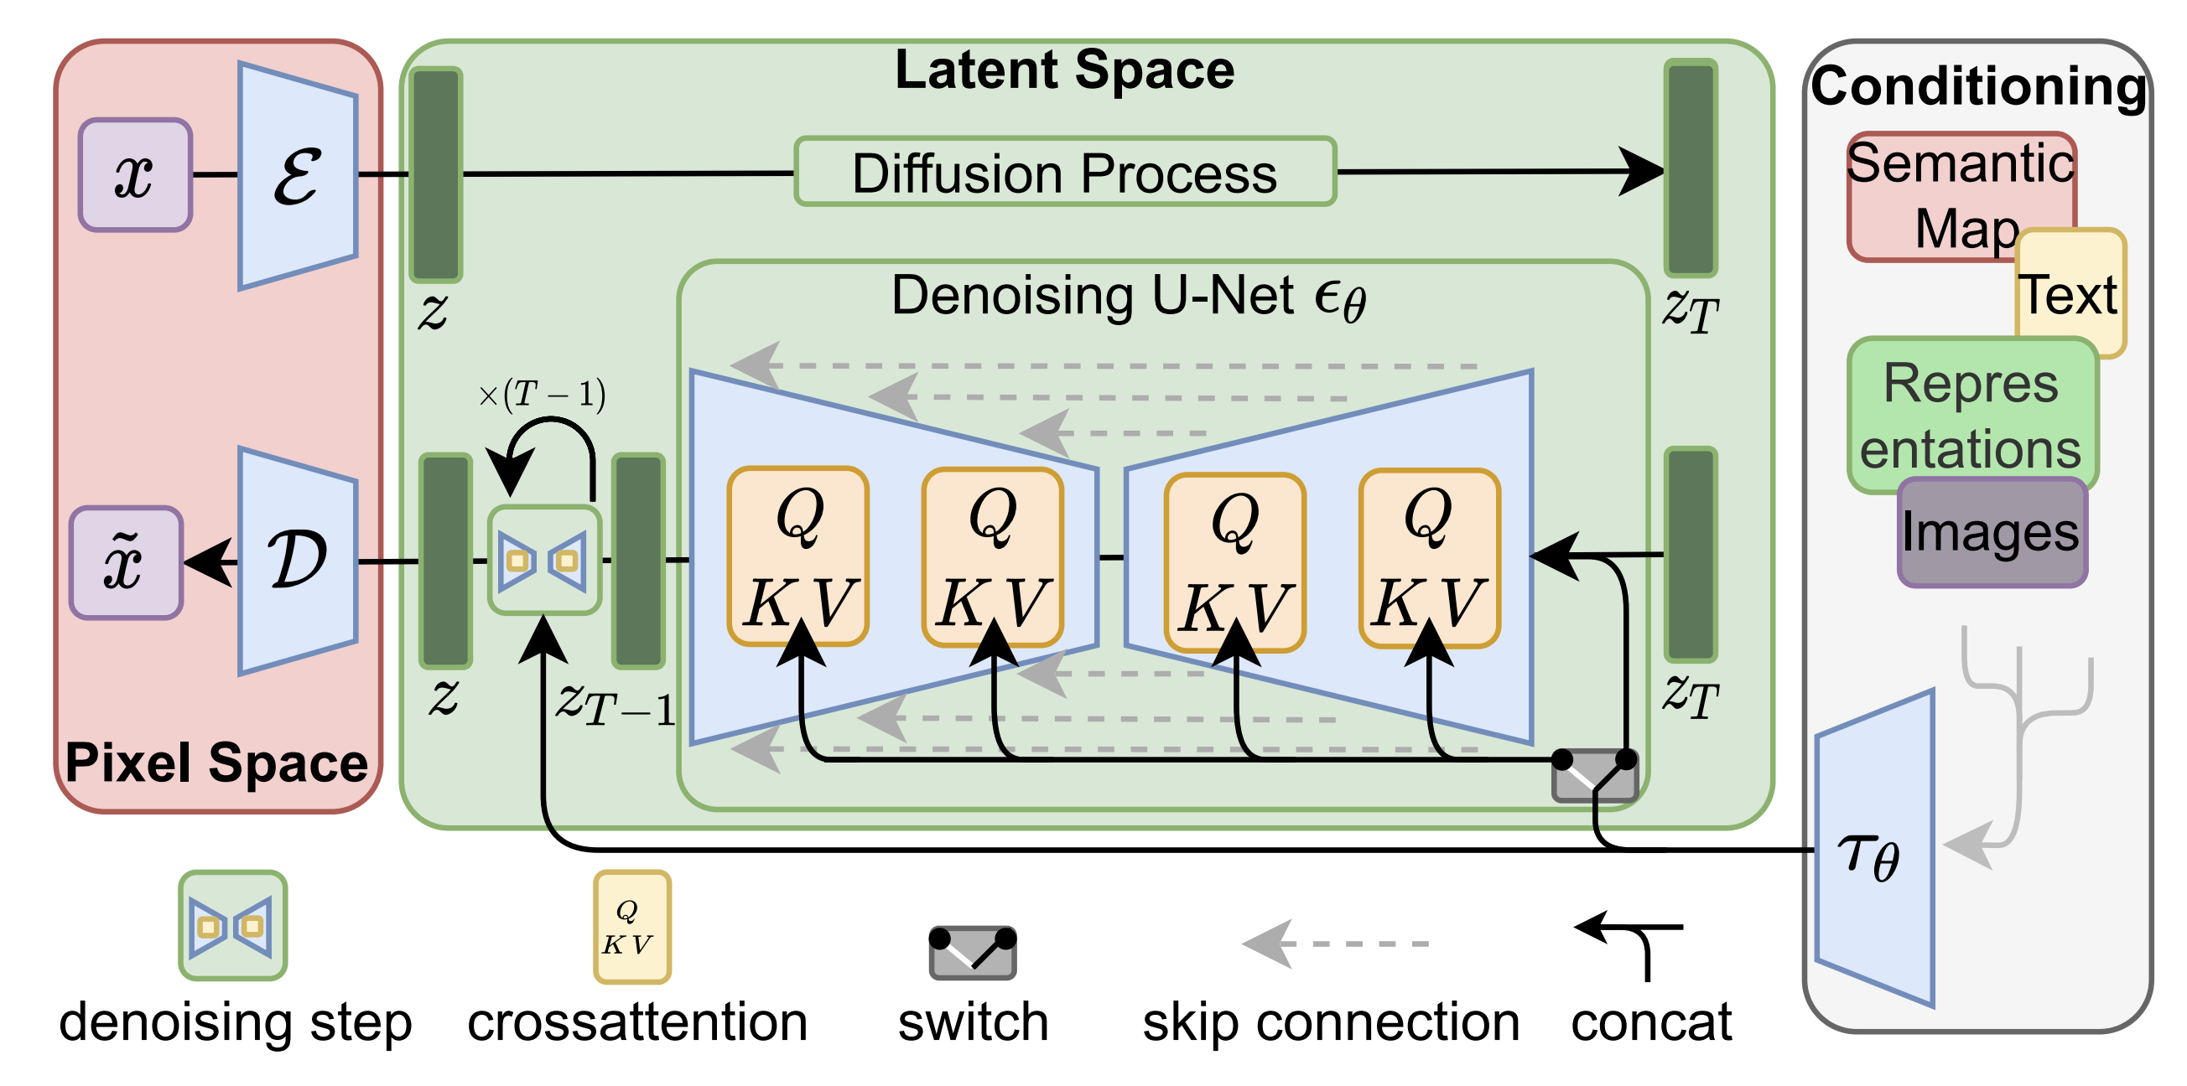
2
1
3
4

Slide 7

Pixel Space to Latent Space

Slide 8
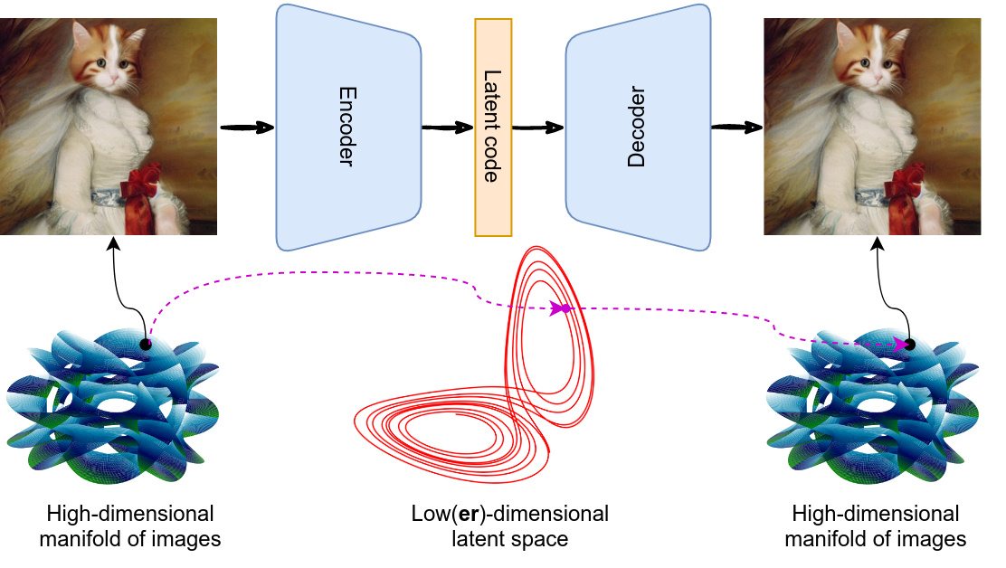
Latent Space
Also known as embedding space.
A learned mathematical space of representations of the data.
Typically unintuitive and hard to interpret, but effective if employed well.

Slide 9
Why Latent Space?
Pixel-space is expensive:
Large memory constraints.
Costly function evaluations.
Less need for quality-reducing compression of previous approaches.
Once a compression model for a latent space has been learned, it and the latent space can be reused to train different generative models.

Slide 10
Perceptual Image Compression
Want a latent space that is perceptually equivalent to larger space.
Autoencoder down samples, with the decoder reconstructing.
Trained via perceptual loss and patch-based adversarial objective.
Uses regularization (KL or VQ) to arbitrarily high-variance latent spaces.

Slide 11
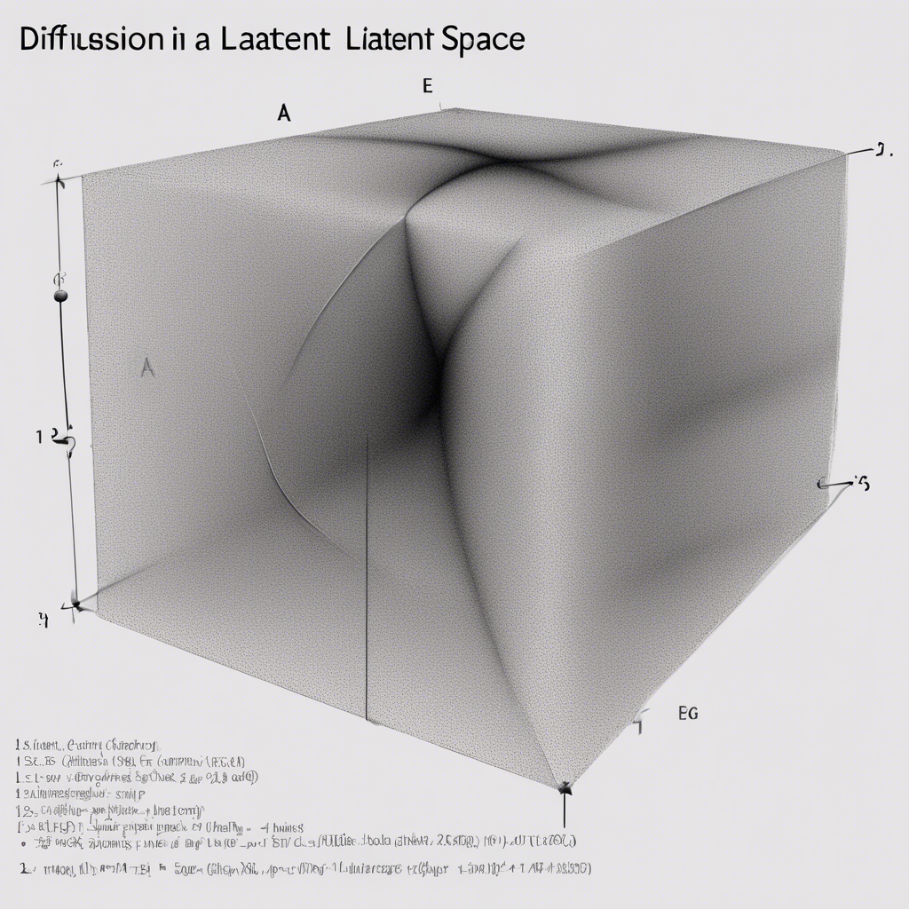
Diffusion in a Latent Space

Slide 12
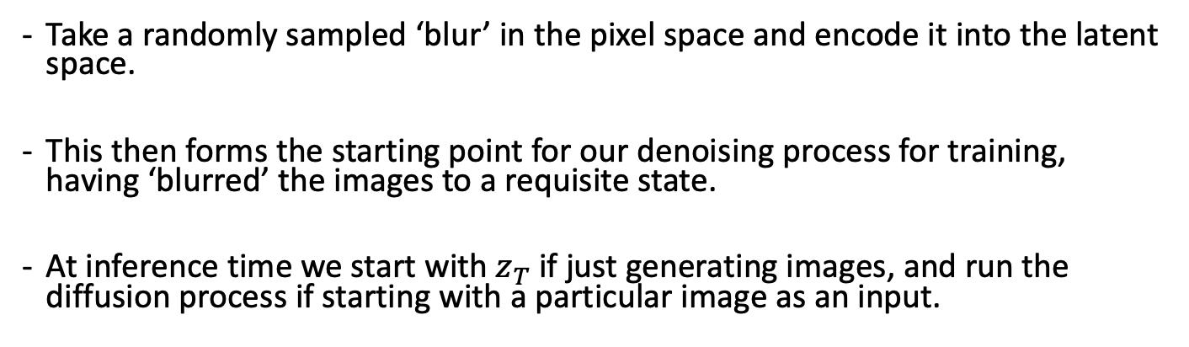
Diffusion in a Latent Space
Take a randomly sampled ‘blur’ in the pixel space and encode it into the latent space.
This then forms the starting point for our denoising process for training, having ‘blurred’ the images to a requisite state.
At inference time we start with $z_{T}$ if just generating images, and run the diffusion process if starting with a particular image as an input.

Slide 13
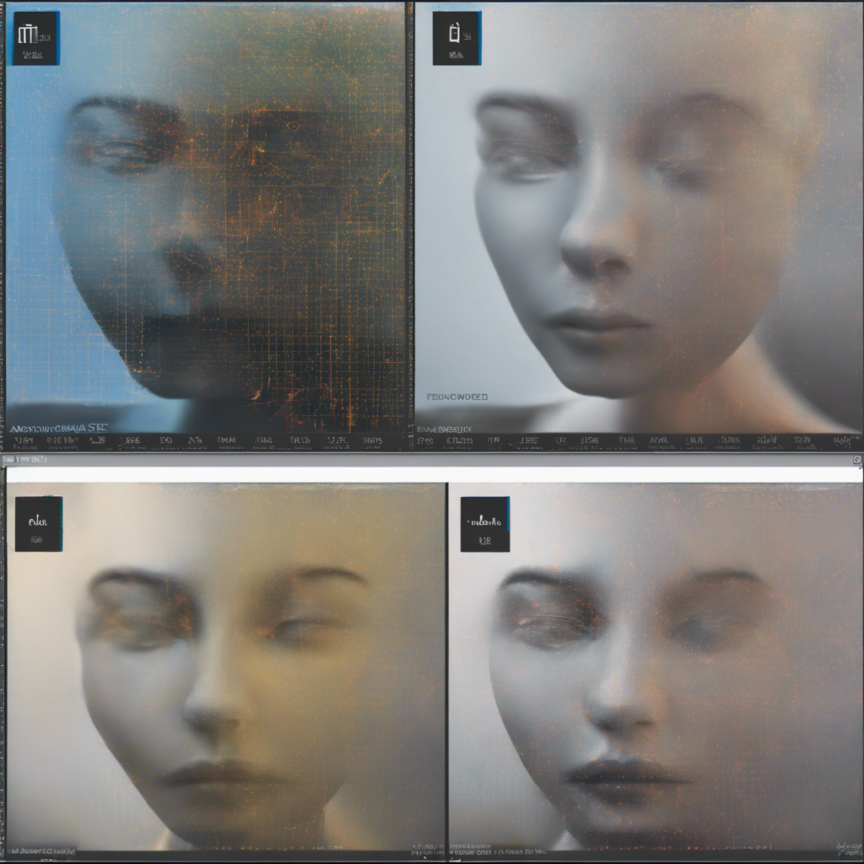
Denoising U-Net with Embedded Cross-Attention

Slide 14
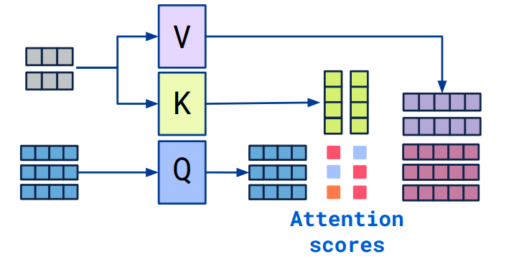
Attention Recap
Mechanism mimicking cognitive attention.
Learns weights for relationship between each input token and each other token.

Slide 15
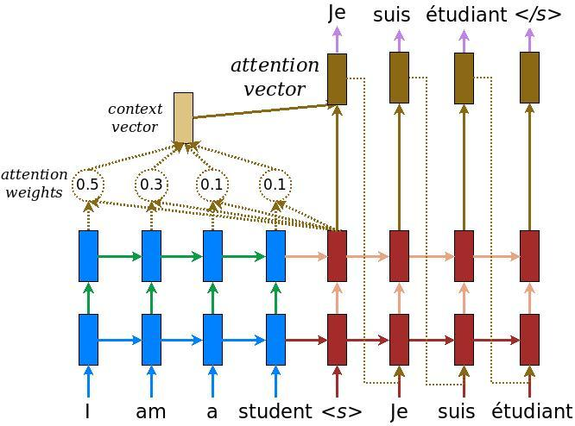
Why Attention?
Effective at learning models with various input modalities.
Interfaces well with pre-trained conditioning systems.
Cross-attention allows for the comparison of two inputs.

Slide 16
Embedded Attention
At each layer of the U-Net a cross attention mechanism relates the context from an embedding to the latent representation.
Each projection matrix is learnable.
At training time the related embedding for a caption is given alongside the image that is being denoised.

Slide 17
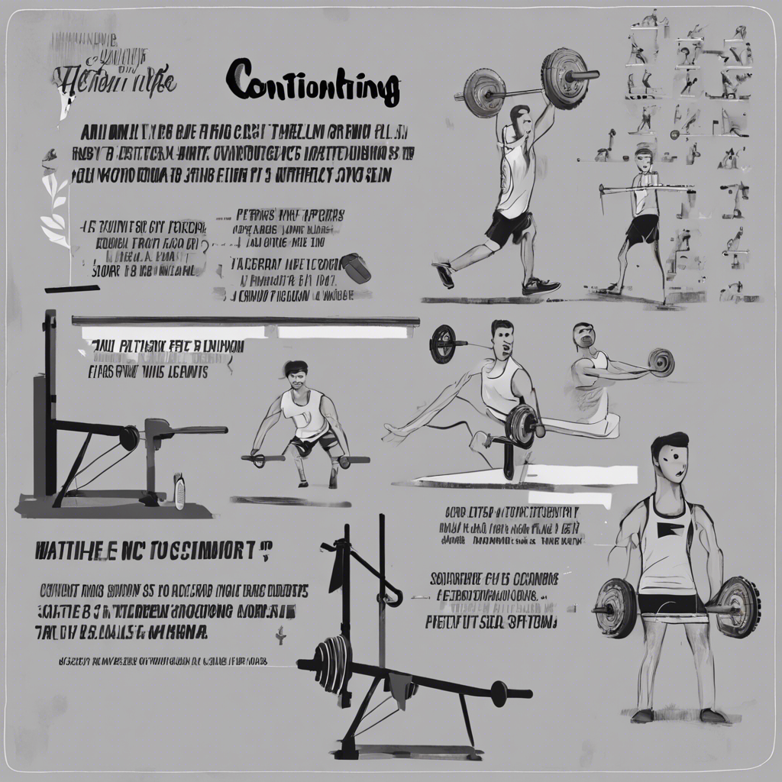
Conditioning

Slide 18
Conditioning Models
In the paper BERT-tokeniser used to provide latent space representations of semantic input.
This is then fed to the U-Net as guidance via cross-attention.
Available version online switched to CLIP.

Slide 19
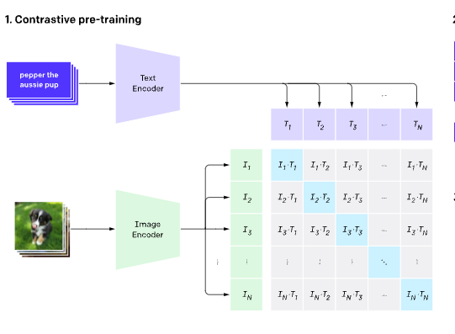
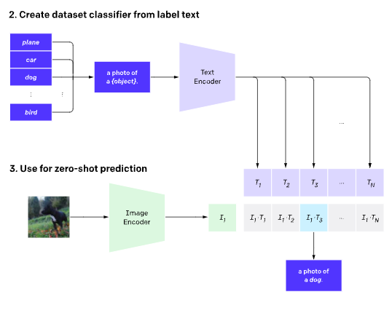
CLIP
CLIP trained on captioned images, providing related embeddings for images and their captions.
Negative examples of mismatched captions and images also used in training.

Slide 20
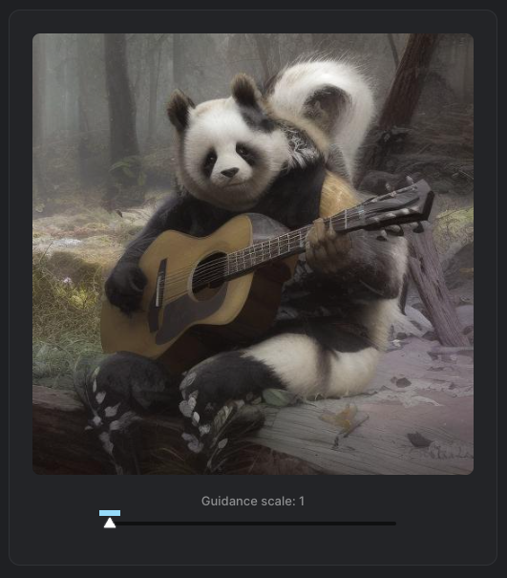
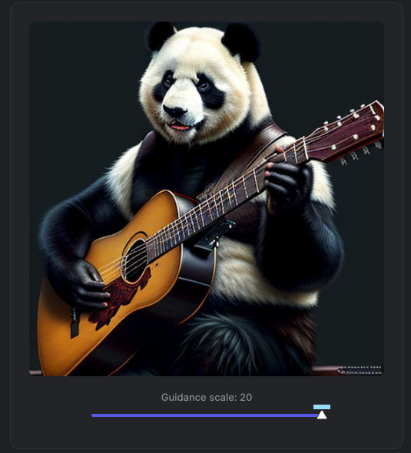
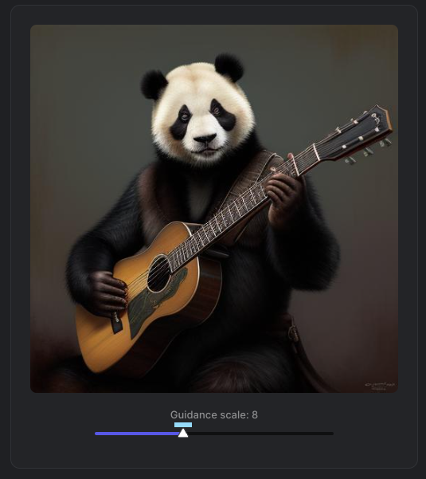
Classifier Free Guidance Scale
A single value hyperparameter that controls how much ‘creativity’ the model has.
Generally advised that a value of ‘around 7-13’ will give the best results, but this varies depending on task.

Slide 21
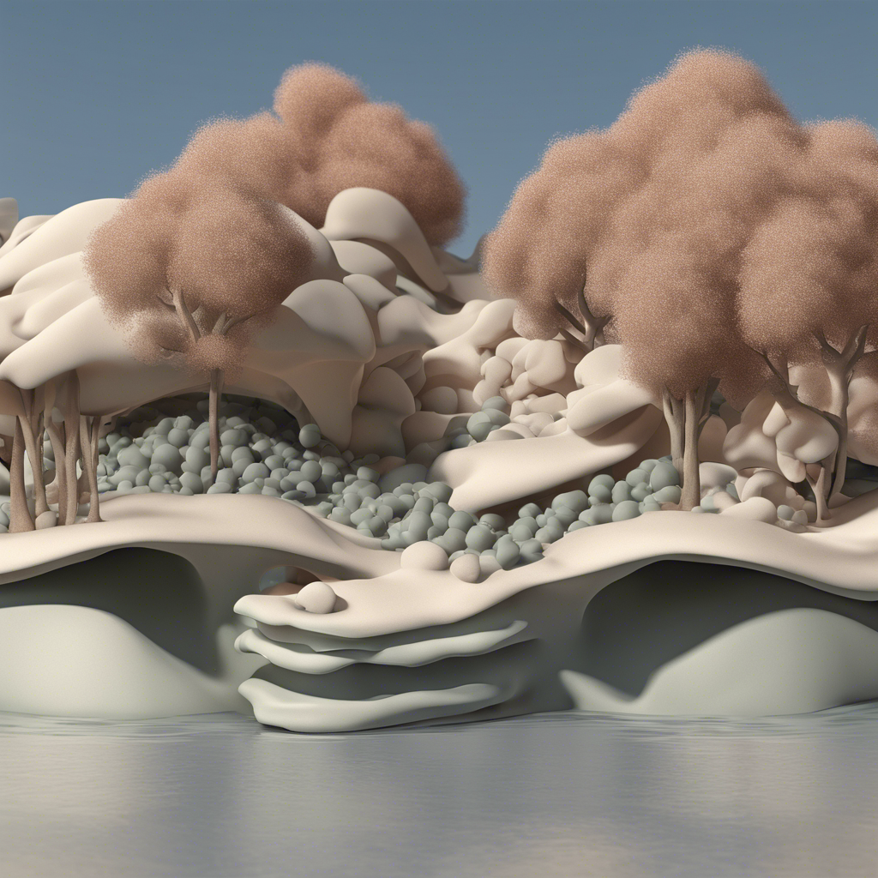
Applications of Stable Diffusion

Slide 22
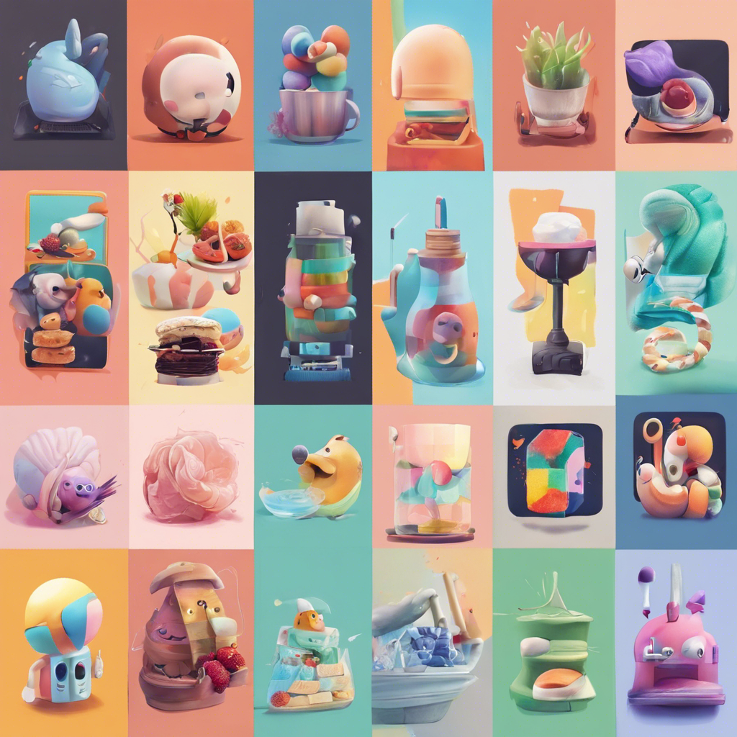
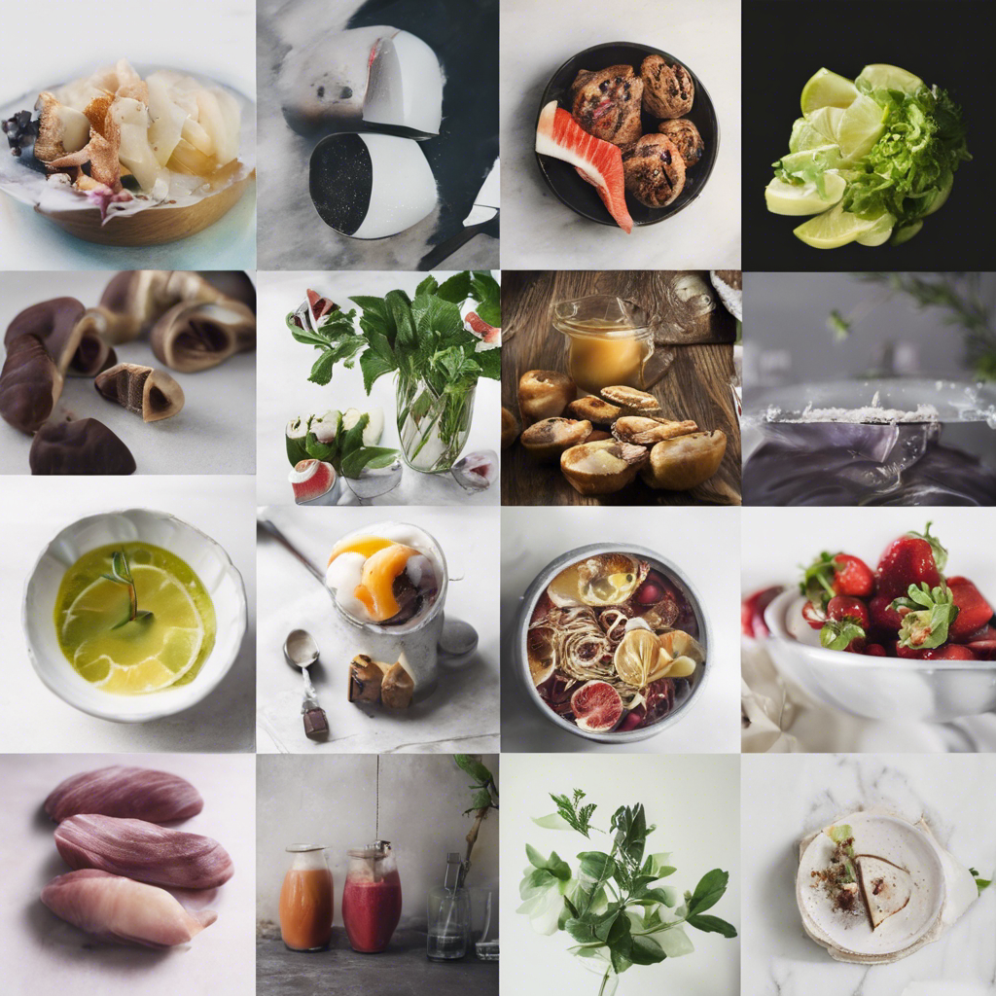

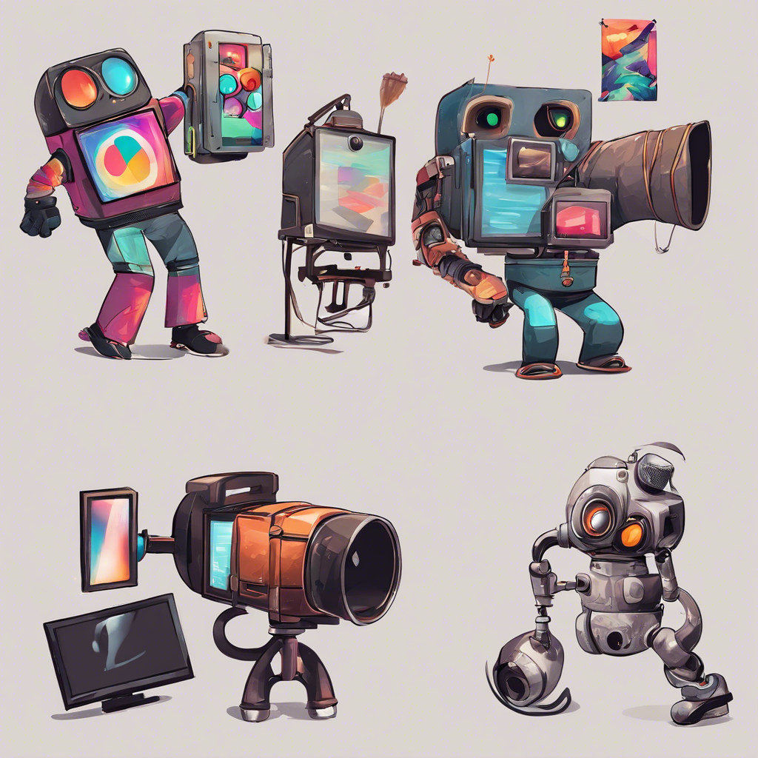
Image Generation

Slide 23
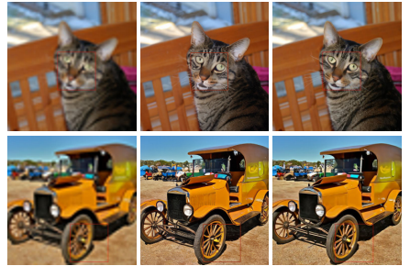
Super Resolution
The latent space method allows for up sampling from an initial resolution efficiently.
Trained on down-sampled images as input, with high resolution images as final output.

Slide 24
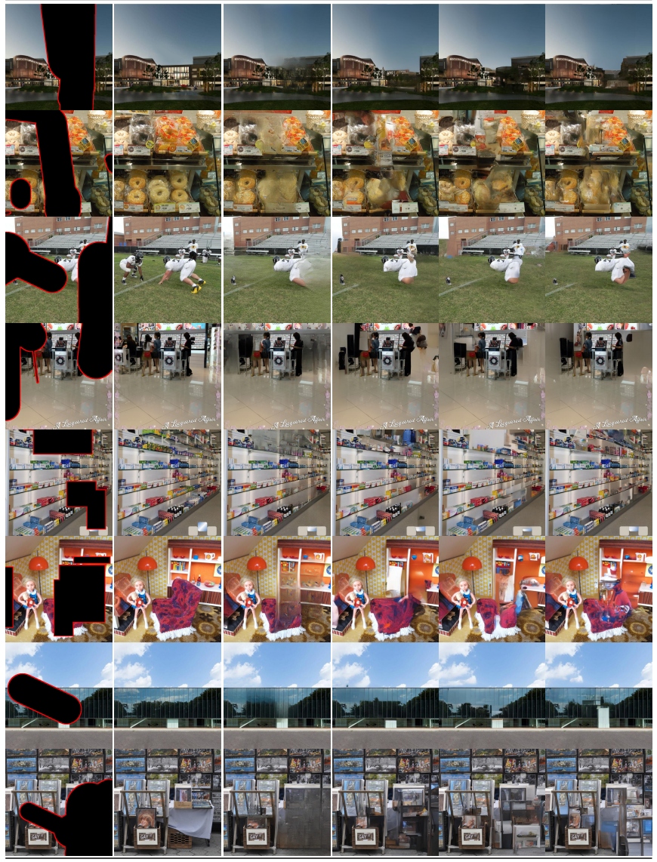
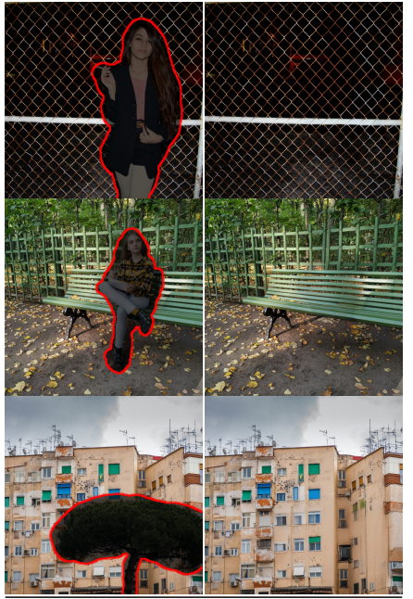
In Painting
The task is to remove an object from the frame.
Training is done by recovering randomly removed segments from images.
Inference input is then an image with the object to be removed cropped out.

Slide 25
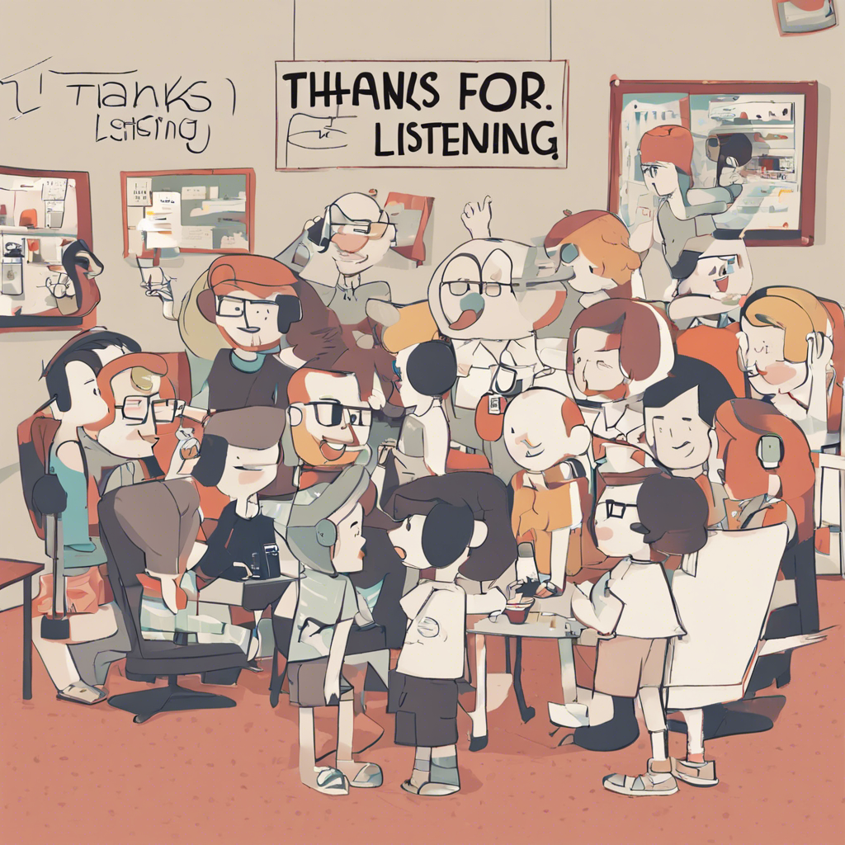
Thanks for Listening!

